Slide 1
Chuan Wang¹, Haibin Huang¹, Xiaoguang Han², Jue Wang¹
Megvii (Face++) USA¹
Shenzhen Research Inst. of Big Data, The Chinese University of Hong Kong, Shenzhen, China²
November 6, 2018

Slide 2


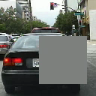
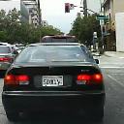
Overview
Contributions:
The first work of deep learning based video inpainting.
Include temporal structure preservation (3D CNN) and spatial detail recovery (2D CNN).
Jointly training of both networks improves the performance of the overall system.

Slide 3
Related Work

Slide 4
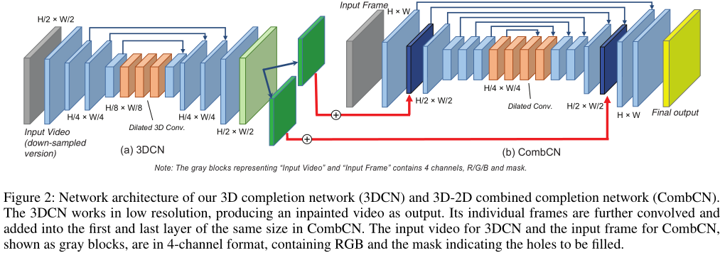
Algorithm
Temporal structure inference by 3DCN
Spatial details completion by CombCN

Slide 5
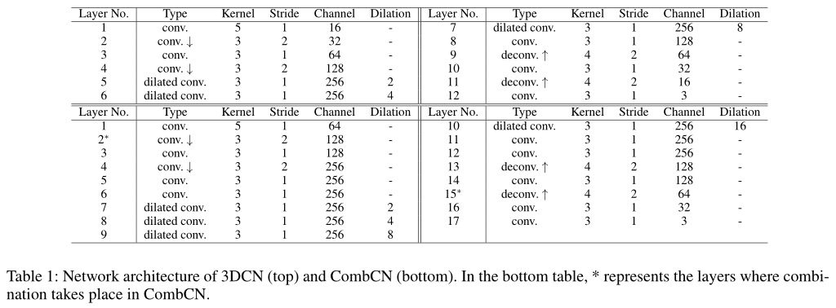
Algorithm

Slide 6
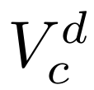
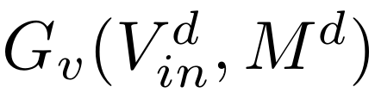
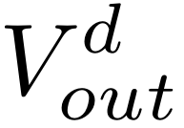
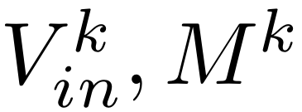
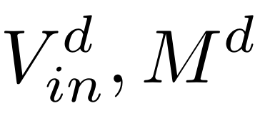
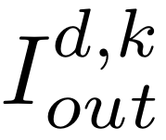
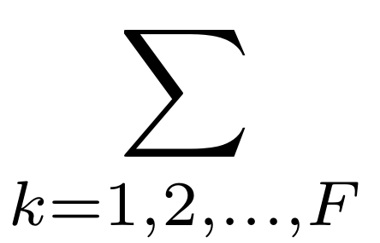
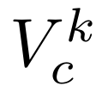
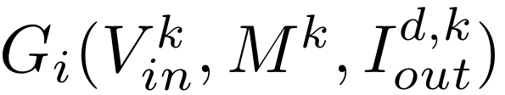
Algorithm
L1 Loss
=
L1 Loss

Slide 7
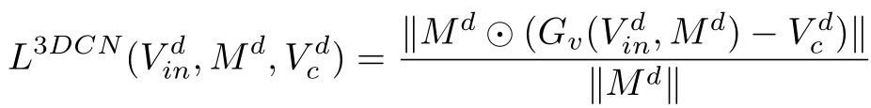
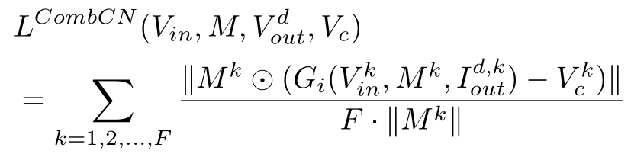
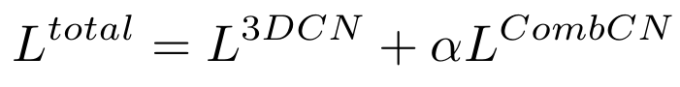
Algorithm
Temporal structure inference by 3DCN
Spatial details completion by CombCN
Jointly Training:

Slide 8


Experiments - Comparisons with existing methods
Dataset FaceForensics
Input
3DCN
2DCN
CombCN
GT

Slide 9
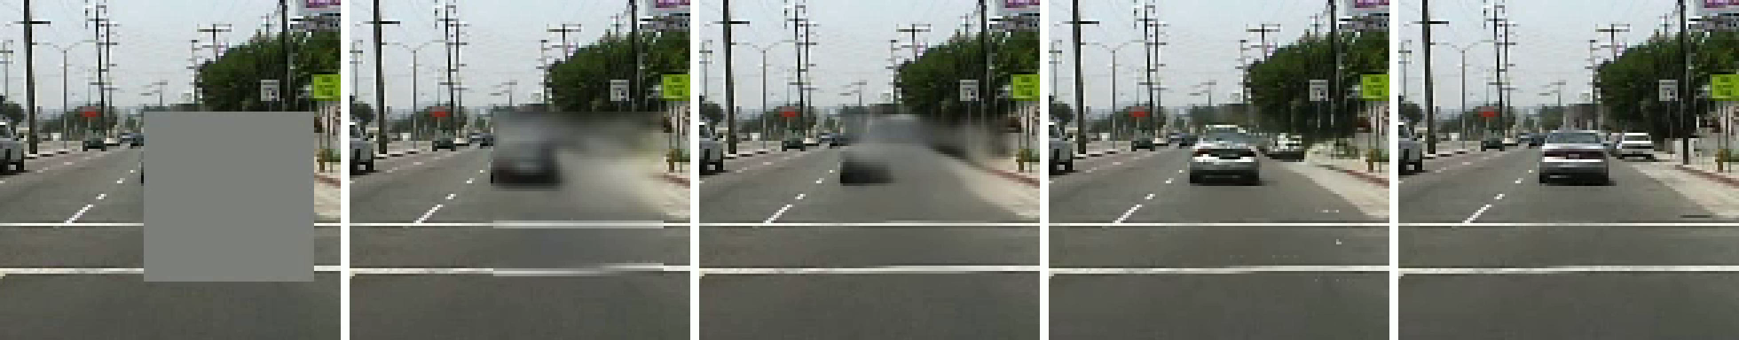
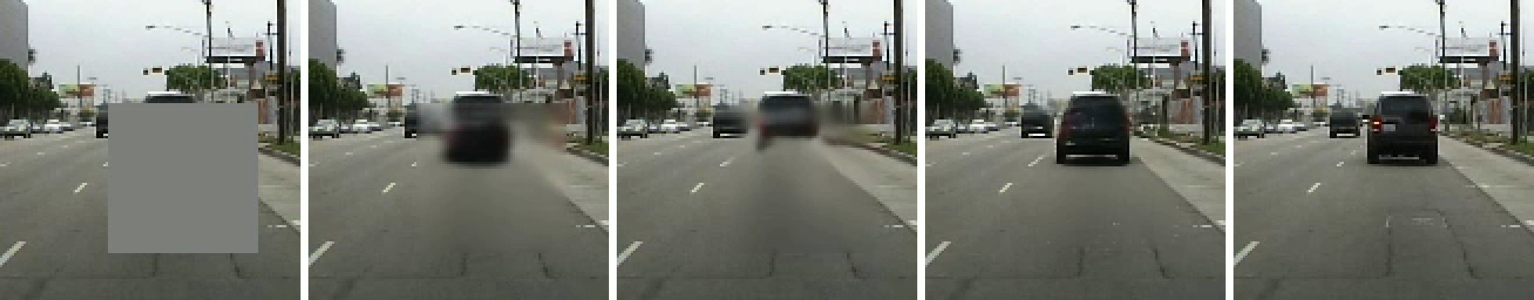
Experiments - Comparisons with existing methods
Dataset Caltech
Input
3DCN
2DCN
CombCN
GT

Slide 10


Experiments - Comparisons with existing methods
Dataset FaceForensics (Random Holes)
Input
3DCN
2DCN
CombCN
GT

Slide 11

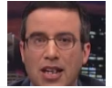

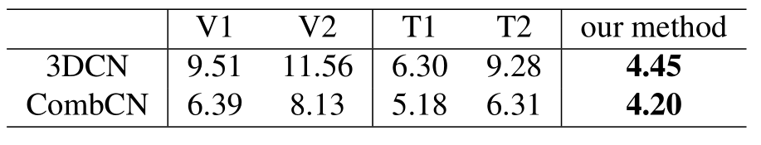
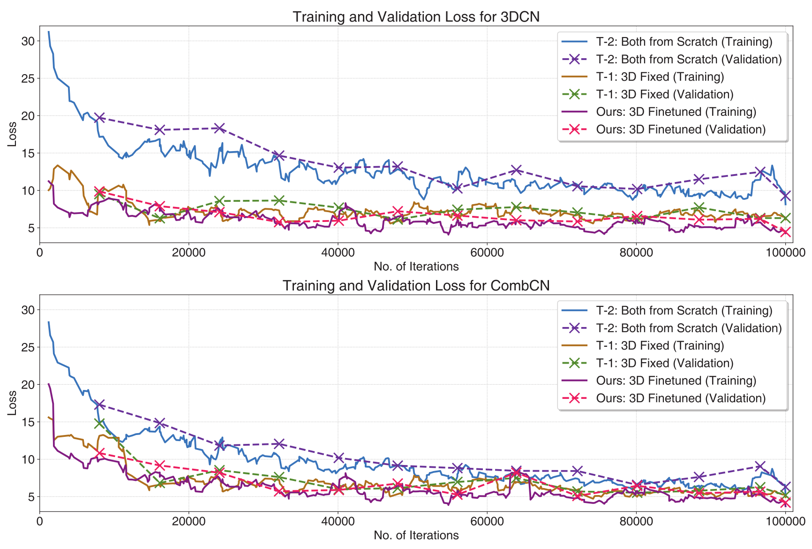
Experiments - Ablation Studies
Performance of variants of 3DCN
V1. Feed 3DCN with videos in lower resolution
V2. Involve down-sampling in time axis in 3DCN
Performance of variants of training strategy
T1. Pre-train 3DCN, then train CombCN without fine-tuning it.
T2. Train 3DCN and CombCN jointly from scratch.
300VW Dataset

Slide 12
More Results
More results could be found at our project page:
http://wangchuan.github.io/archive/research/videoinp/

Slide 13
Thank You

